Slide 1
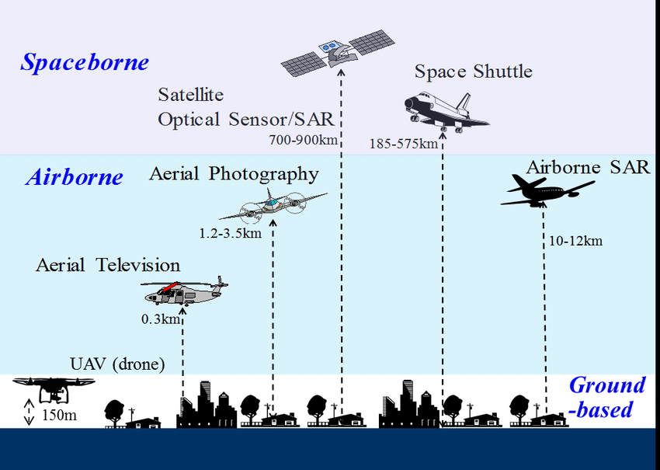
Sensors and Platforms

Slide 2
Sensors
Two main categories
Passive sensors (use energy from the Sun)
Active sensors
Emit their own source of energy
Methods include radar (radio), lidar (light) and sonar (sound)

Slide 3
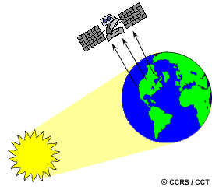
Passive Sensors
Passive sensors can only be used to detect energy when the naturally occurring energy is available.
For all reflected energy, this can only take place during the time when the sun is illuminating the Earth.
There is no reflected energy available from the sun at night.
Energy that is naturally emitted (such as thermal infrared) can be detected day or night, as long as the amount of energy is large enough to be recorded.

Slide 4
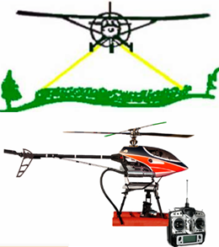
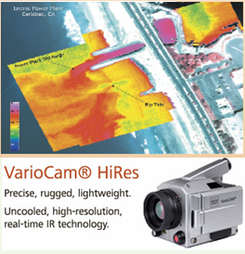
Passive Sensors Cont..
Aerial camera
aerial photography
topographic and cadastral mapping
currently more digital
Video Camera
predominantly visible spectrum
thermal infrared
low cost image data for reconnaissance or qualitative purposes
cannot be used for detailed mapping

Slide 5
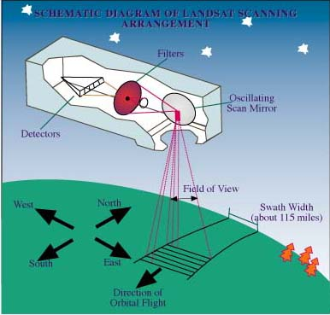
Passive Sensors Cont..
Multispectral Scanner
line scanning devices observing the Earth perpendicular to the orbital track
Scanning ACROSS the flight direction is achieved by oscillation (rotation) of a mirror.
measures sunlight in visible and infrared spectrum…vegetation or mineral characteristics of top soil layers

Slide 6
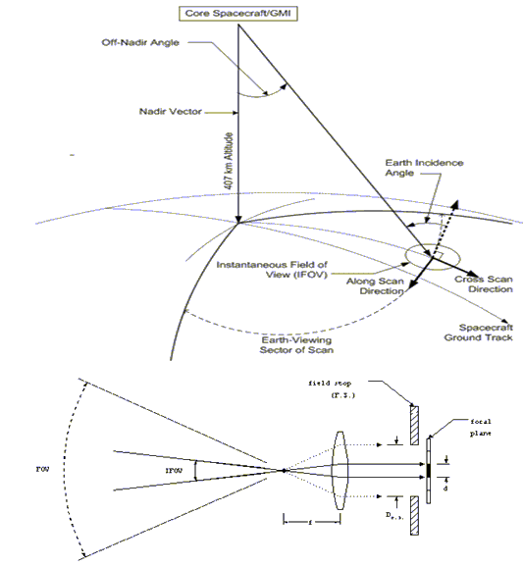
Multispectral Scanner
Scanners IFOV (Instantaneous Field of View) with a narrow field of view that sweeps over the terrain
Viewing angle Nadir/Off-Nadir for Pointable sensor
Common methods of scanning
across-track scanning (whisk-broom scanner)
along-track scanning (push-broom scanner)

Slide 7
Limitations of Multispectral scanners
Limited Spectral Resolution: Multispectral scanners typically capture data in a limited number of discrete spectral bands.
Incomplete Spectral Coverage: While multispectral scanners capture data in multiple bands, there may still be gaps in the spectral coverage.
Reduced Sensitivity to Narrow Features: Multispectral scanners may not effectively capture information from narrow features or small objects due to the relatively broad spatial resolution of the scanner
Lack of Continuous Data: Multispectral scanners capture data in discrete bands, which means that the spectral information is not continuous across the entire electromagnetic spectrum.

Slide 8
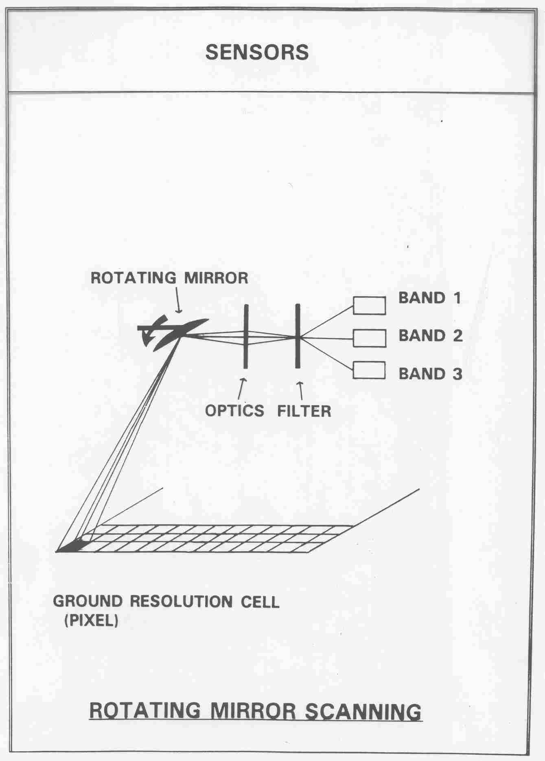
Whiskbroom scanners
Single detector plus rotating mirror used
Detector beam sweeps in a straight line across the satellite track

Slide 9
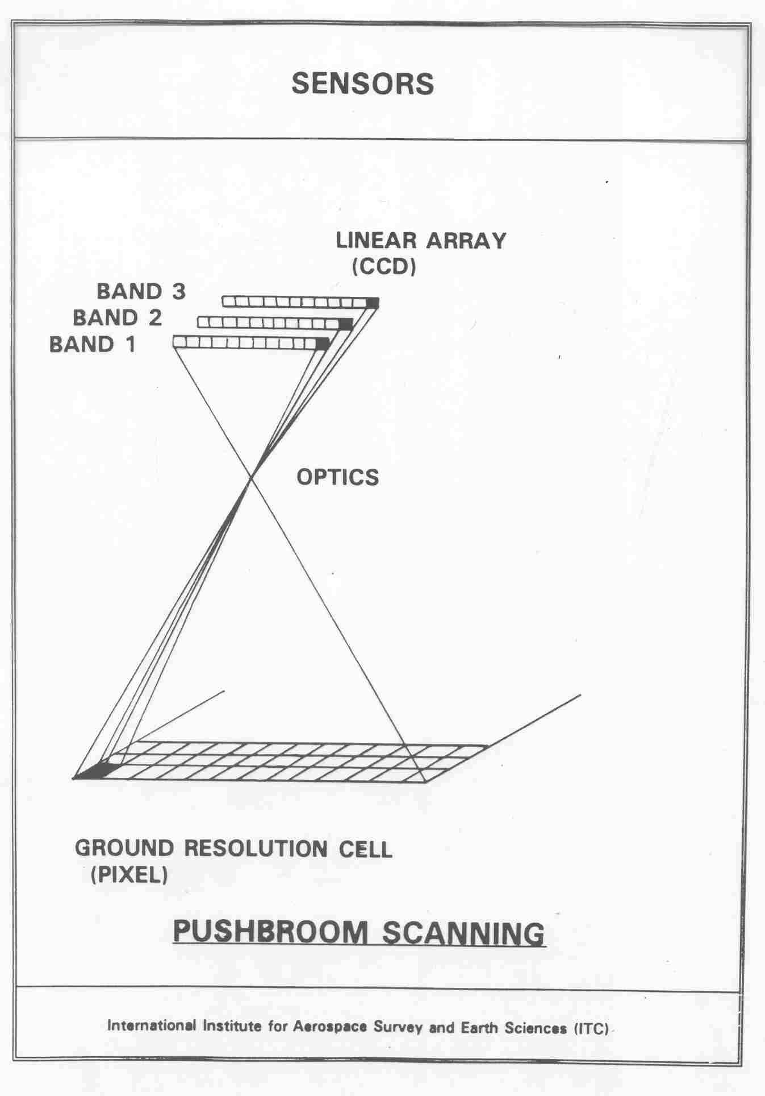
Push broom scanners
Based on charge coupled devices (CCD) for measuring EME.
CCD array – a line of photo-sensitive, solid state detectors
Records one entire line at a time
Each position in the line has its own detector
Builds up images by scanning entire lines along the direction of motion of the platform
Stable geometry & less noise
No use of a mirror

Slide 10
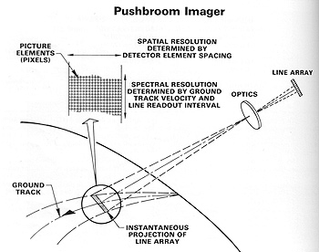

Slide 11
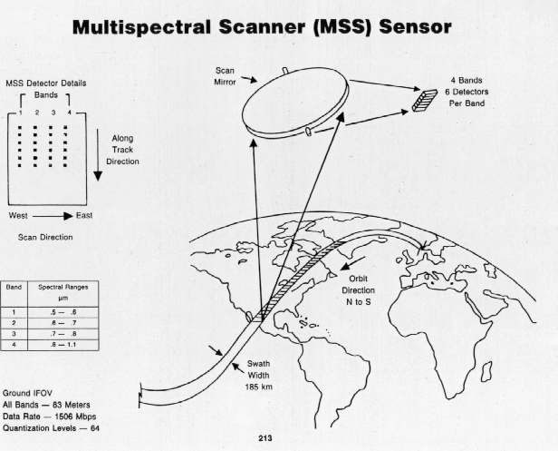
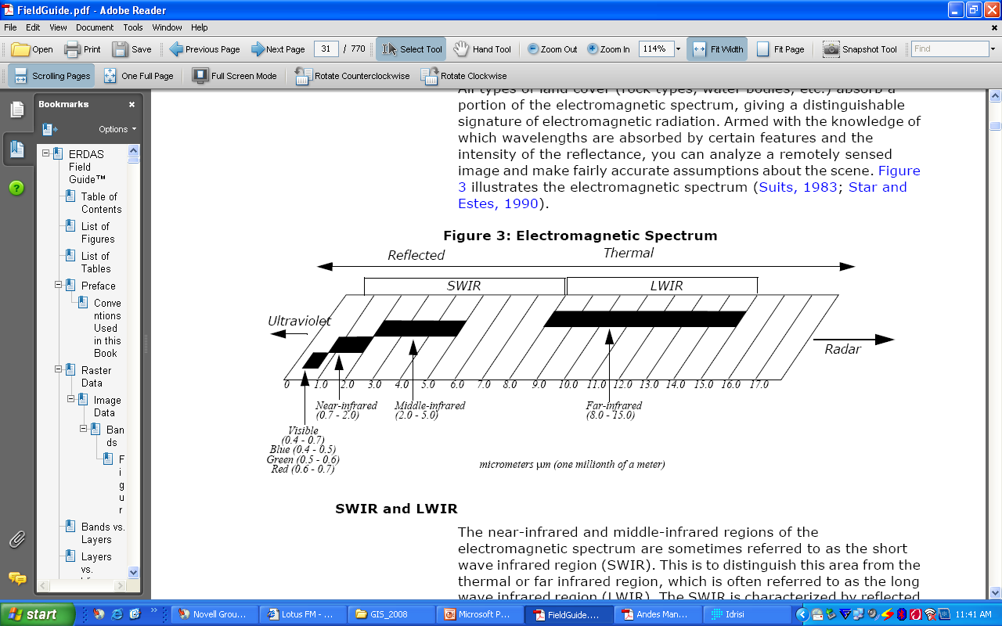
Passive Sensors Cont..
Thermal Scanner
thermal data in 8-14 micro m range, directly related to an object’s temperature
meteorology

Slide 12
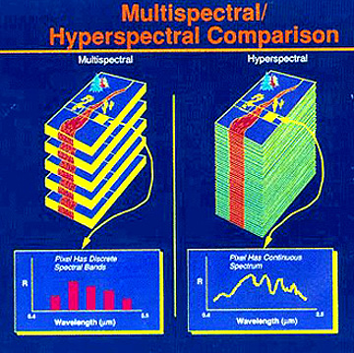
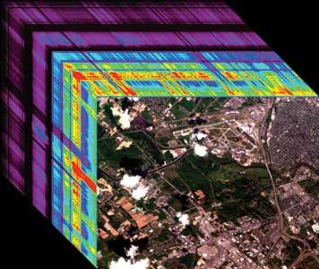
Passive Sensors Cont..
Imaging Spectrometer ("hyperspectral sensors“)
Measures the narrow spectral bands (0.005-0.01micro m)
Species Mapping
Plant physiology
Pathogen detection , etc.

Slide 13
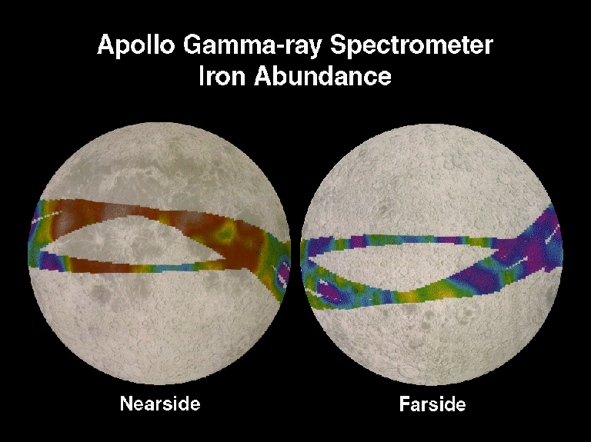
Passive Sensors Cont..
Gamma-ray spectrometer
measures gamma rays emitted by upper soil or rock layers…used for mineral exploration
e.g. Uranium naturally radioactive and emit gamma-rays as part of their radioactivity.

Slide 14
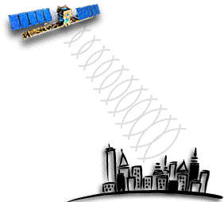
Active Sensors
The sensor emits radiation which is directed toward the target to be investigated.
The radiation reflected from that target is detected and measured by the sensor.
Advantages for active sensors
ability to obtain measurements anytime, regardless of the time of day or season.
Active sensors can be used for examining wavelengths that are not sufficiently provided by the sun, such as microwaves
Can better control the way a target is illuminated.

Slide 15
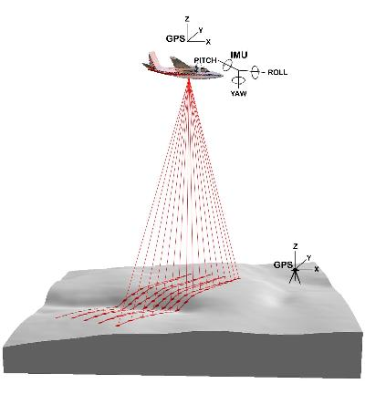
Active Sensors
Laser Scanner
lidar
travel time & returned intensity are measured parameters
To produce high resolution DTM’s

Slide 16
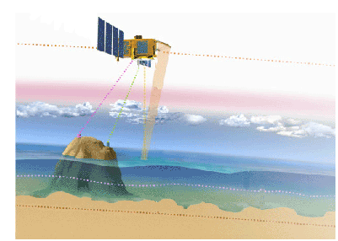
Active Sensors
Radar Altimeter (non-imaging)
topographic profile parallel to satellite orbit
calculates the distance, or range, between the satellite and the sea surface
provide single lines of measurements rather than image data
useful for measuring smooth surfaces

Slide 17
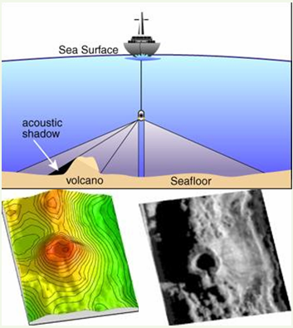
Active Sensors
Side Scan Sonar
transmits specifically shaped acoustic beam & measures reflected pulse
used for sea floor topography

Slide 18
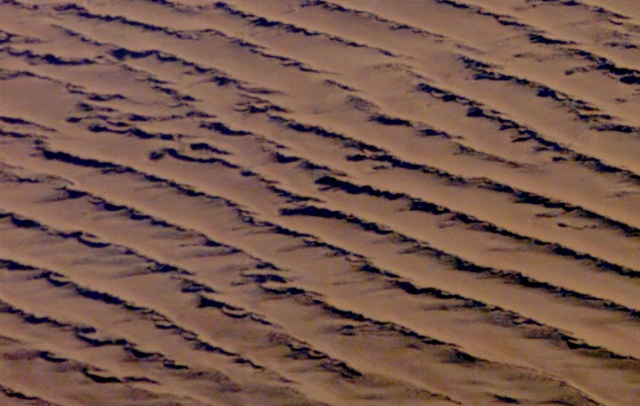
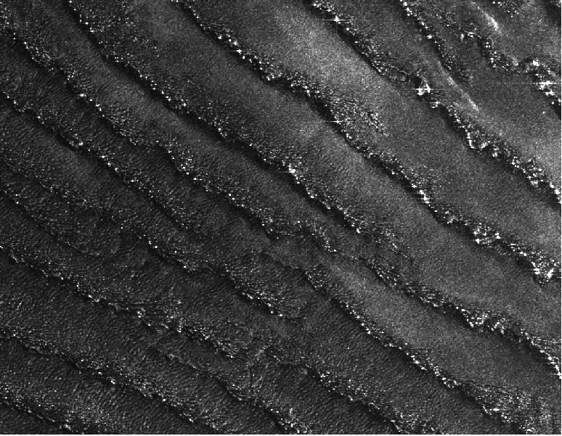
Active Sensors
Imaging Radar
1-100cm range
assess changes in height or vertical deformations (land subsidence) or crustal deformation (earthquakes)

Slide 19
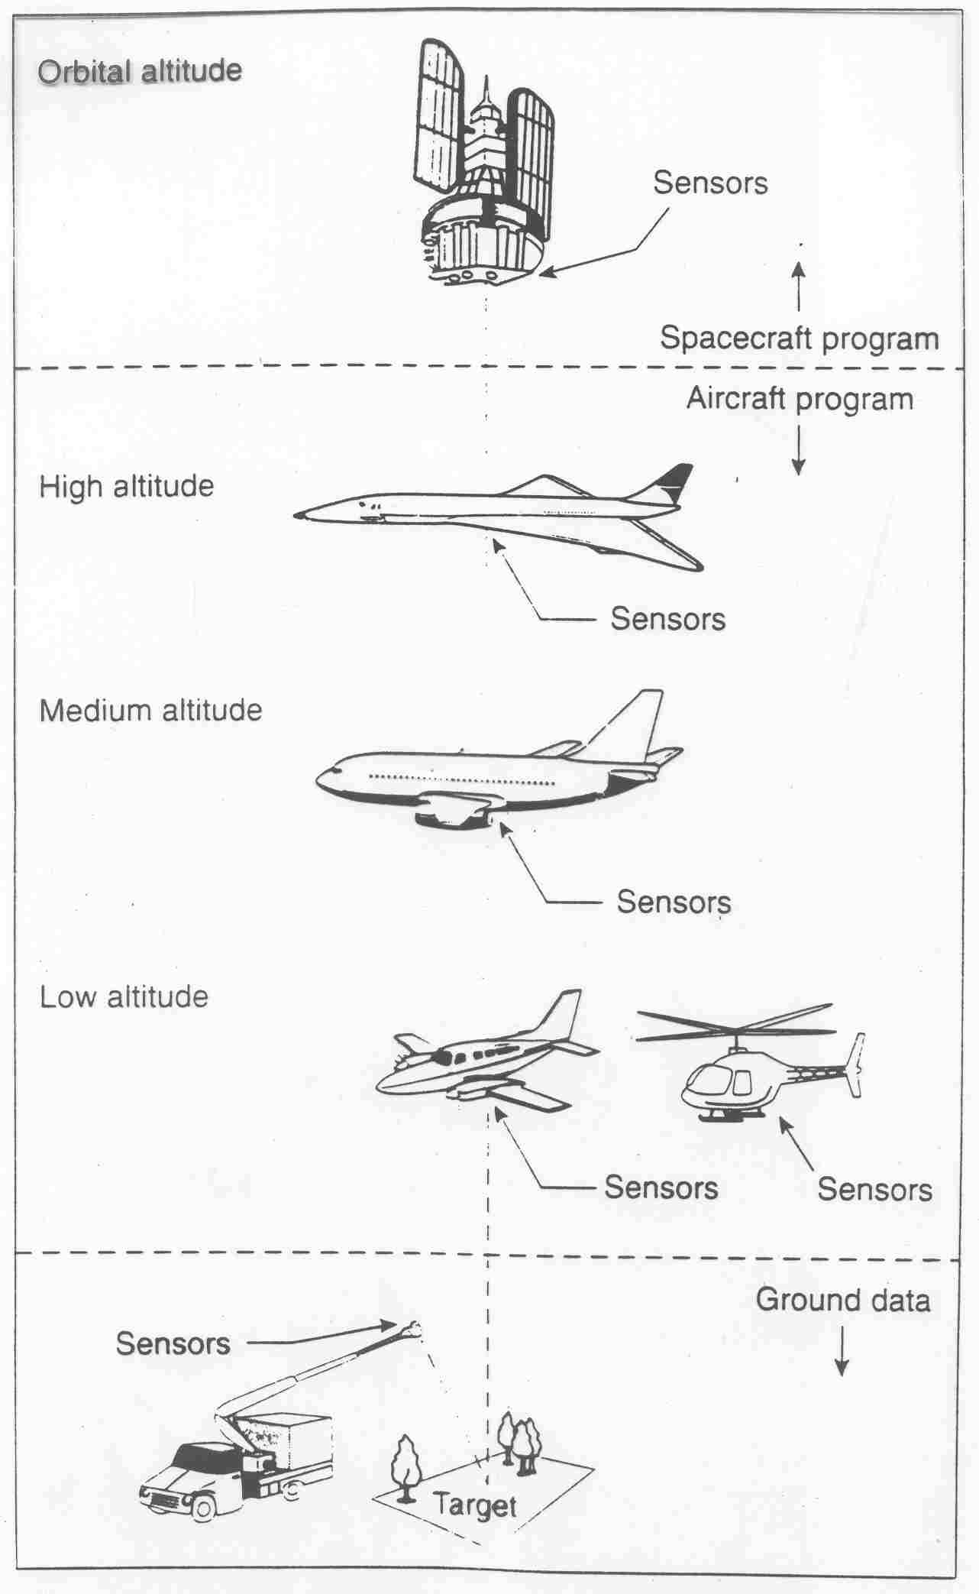
Platforms
Two main categories:
Airborne: specifically modified aircraft, balloons, helicopters, airships or kites
Spaceborne: satellites and space stations
Ground based: Phenology cameras
Platforms can host 1 or more sensors

Slide 20
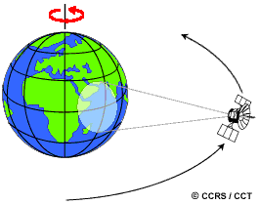
Orbits
The path followed by a satellite is referred to as its orbit.
Satellite orbits are matched to the capability and objective of the sensor(s) they carry.
Orbit selection can vary in terms of altitude (their height above the Earth's surface) and their orientation and rotation relative to the Earth.

Slide 21
Spaceborne Remote Sensing
Monitoring capabilities are determined by orbit parameters such as:
Orbital altitude
Orbits typically between 150km and 36000km altitude for earth observation.
Orbital inclination angle
The angle between orbital plane and equatorial plane.
Orbital period (temporal resolution)
Time required to complete 1 full cycle

Slide 22
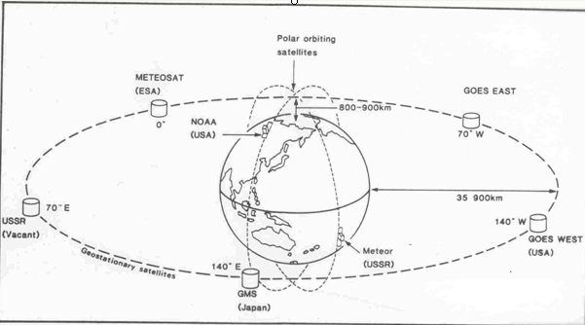
Geostationary satellites
A Geostationary satellites, is a circular orbit 35,786 kilometres above the Earth's equator and following the direction of the Earth's rotation. A satellite in such an orbit has an orbital period equal to the Earth's rotational period (one sidereal day), and thus appears motionless, at a fixed position in the sky, to ground observers.
Weather and communication satellites

Slide 23
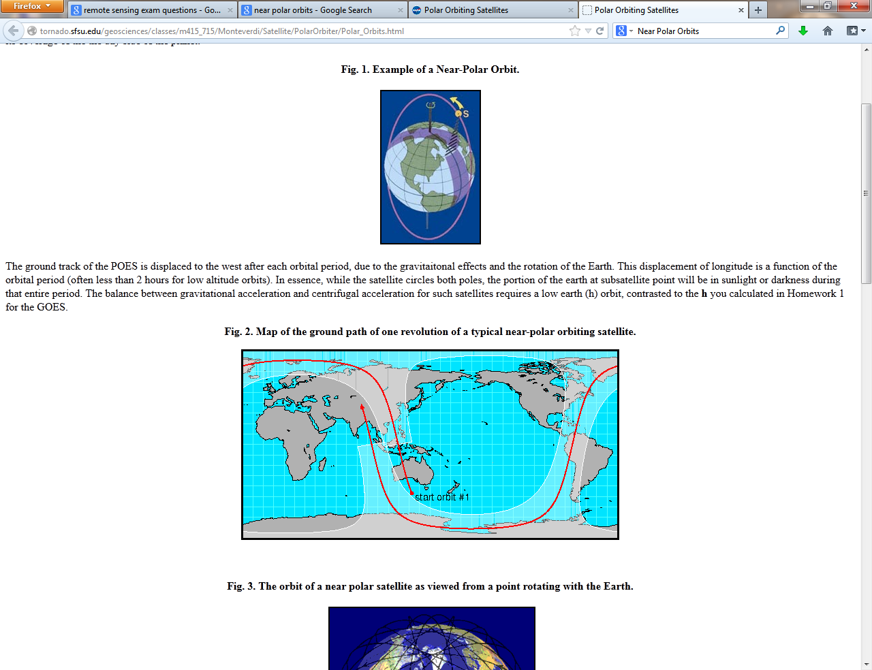
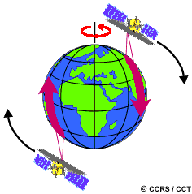
Near Polar Orbits
A polar orbit is an orbit in which a satellite passes above or nearly above both earth poles, basically (north-south). A satellite in a polar orbit passes over the equator at a different longitude on each of its orbits.
Earth's rotation (west-east), is taken into consideration
Many of these satellite orbits are also sun-synchronous such that they cover each area of the world at a constant local time of day called local sun time.
Often used for earth mapping, earth observation

Slide 24
Near Polar Orbits
Ensures consistent illumination conditions when acquiring images in a specific season
over successive years,
over a particular area
over a series of days.
Important for monitoring changes between images.

Slide 25
Selection of Satellite Data
Purpose of data is important.
- e.g. Urban mapping requires a high spatial resolution images, mapping soils/ geology
Height information can be obtained by stereo images/radar or lidar
Satellite sensor parameter i.e. spectral, spatial resolution, temporal resolution for monitoring fires, crops, etc.
Software-Computer availability.
Data availability of the area under consideration.
Quality of data (e.g. % cloud cover).

Slide 26
AVHRR
30 meters
Hyperion
MODIS
20 meters
Landsat 5 to 8
ASTER
Radarsat
10 meters
Sentinel 1 & 2
5 meters
SPOT
IRS
OrbView
Ikonos
2 meters
Ground Resolution
Worldview
1 meter
PixSat
QuickBird
2 feet
1 foot
Aerial Imagery
6 inches
Not Time Critical
Near Real Time
Access Time

Slide 27
Some of the Sensors

Slide 28
Landsat (Land Satellite)
Originally called Earth Resources Technology Satellite
Landsat-1 launched on 23 June 1972
Sun-synchronous orbit
Altitude 918km
Measured 0.4 - 1.1nm bandwidth
Operated by NOAA (Notional Oceanic and Atmospheric Administration)

Slide 29
Landsat Series
Landsat 1 – launched 1972
Landsat 2 – launched 1975
Landsat 3 – launched 1978
Landsat 4 – launched 1982
Landsat 5 – launched 1984* still active
Landsat 6 – lost at launch - 1993
Landsat 7 – launched 1998* still active
Landsat 8 launched 2013

Slide 30
Landsat 1 - 3
MSS sensor (Multispectral Scanner)
8 bit
4 multispectral bands
4 Visible and NearIR (VNIR)
80 m

Slide 31
Landsat 4 and 5
TM sensor (Thematic Mapper)
The Thematic Mapper (TM) is an advanced, multispectral scanning, designed to achieve higher image resolution, sharper spectral separation, improved geometric fidelity and greater radiometric accuracy and resolution than the MSS sensor.
8 bit
7 multispectral bands
4 visible and nearIR (VNIR) – 30m
2 SWIR – 30m
1 thermal (LWIR) – 120m

Slide 32
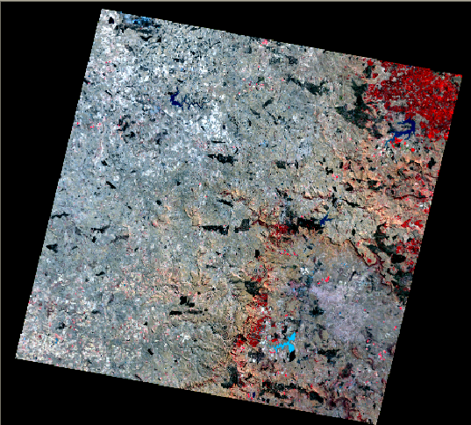
Landsat TM

Slide 33
Landsat 7
Carries the ETM+ sensor (Enhanced Thematic Mapper +) on board.
8 bit
705 km
1 Panchromatic band – 15m
8 multispectral bands
4 visible and nearIR (VNIR) – 30m
2 SWIR – 30m
2 thermal (LWIR) – 60m
VISIBLE
NIR
SWIR
500
600
700
800
900
1000
nm
1
2
3
4
Notes:
http://eosims.cr.usgs.gov:5725/DATASET_DOCS/landsat7_dataset.html

Slide 34
ETM+ useful websites
http://edcdaac.usgs.gov/main.html
http://landsat.gsfc.nasa.gov/
http://edcdaac.usgs.gov/main.html

Slide 35
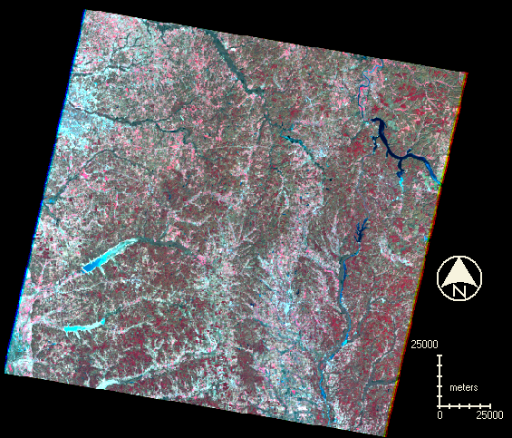
P22R36 Jan 2000 – 30m Landsat7

Slide 36
AVHRR
Advanced Very High Resolution Radiometer
NOAA - Small scale earth reconnaissance
5-channels
580 – 680 nm (red)
725 – 1100 nm (NIR)
3550 – 3930 nm (mid IR)
10.3 – 11.3 μm (thermal)
11.5 – 12.5 μm (thermal)
VISIBLE
NIR
SWIR
400
500
600
700
800
900
1000
nm
1
2
1.1 km
Notes:
America's First Generation era of geostationary satellites began in 1966 with the Applications Technology Satellite (ATS) series. The Spin-Scan Cloud Camera (SSCC) and the Multicolor Spin-Scan Cloud Camera (MSSCC) provided the first images of the Western Hemisphere from 35,800 km. This R&D program led to the Synchronous Meteorological Satellite/Geostationary Operational Environmental Satellite (SMS/GOES). SMS-1 was launched in 1974. The instruments provided visible (1km resolution) and infrared data (8km resolution) that were used to produce time sequences of weather patterns for forecasting. GOES satellites have been used in pairs, one occupying a position above 135°W longitude (known as GOES West) and one above 75°W longitude (GOES East). Combined, these provide weather data for the Western Hemisphere. Satellites operated by Europe (METEOSAT), Japan (GMS), and India (Insat) provide data for the remainder of the globe.GOES-8 and following change from spinning platforms to 3 axis stabilized to increase observational dwell time (see box on GOES Second Generation).
GOES 8-M are designed to operate in geosynchronous orbit 35,790km above the Earth and to thereby continuously view the continental United States, neighboring environs of the Pacific and Atlantic Oceans, and Central and South America. The three-axis, body-stabilized spacecraft design enables the sensors to "stare" at the Earth to more frequently image clouds, monitor Earth's surface temperature and water vapor fields, and sound the atmosphere for its vertical thermal and vapor structures. Each of the GOES 8-M platforms will carry an imaging and sounding sensor and will be 3-axis stabilized. A single wing solar array rotates about the satellite pitch axis to track the sun to generate 1057W of energy. A conical solar sail on a 16m boom balances the torque generated by solar pressure. The second generation imager is a 5-channel instrument whose purpose is to measure clouds, water vapor, surface temperature, winds, surface albedo, and phenomena like smoke and fire. The Sounder is a 19-channel sensor with one visible channel at 0.70µm, and 18 channels of LWIR between 3.74µm and 14.71µm. Four channels are selected for surface temperature sensing, 10 channels for temperature sounding, 3 for water vapor sounding, and one for total ozone measurement.

Slide 37
AVHRR
Used for weather forecasting and sea surface temperature mapping
Currently, 3 sensors are active on NOAA satellites
Free to researchers
Sites:
http://edcwww.cr.usgs.gov/glis/hyper/guide/avhrr
http://fermi.jhuapl.edu/avhrr/
http://edcdaac.usgs.gov/main.html
Notes:
Obtain data from EROS
Customer Services U.S. Geological Survey EROS Data Center Sioux Falls, SD 57198 USA Tel: 605-594-6151 1-800-252-GLIS Fax: 605-594-6589 TDD: 605-594-6933 E-Mail (Internet): custserv@edcmail.cr.usgs.gov URL: http://edc.usgs.gov/

Slide 38
Meteosat
Geostationary
altitude 36000km
No. 1 launched on 14 May 1979
records data every half hour
visible, near infra-red and middle infrared ranges
meteorological studies, landcover mapping and monitoring natural disasters

Slide 39
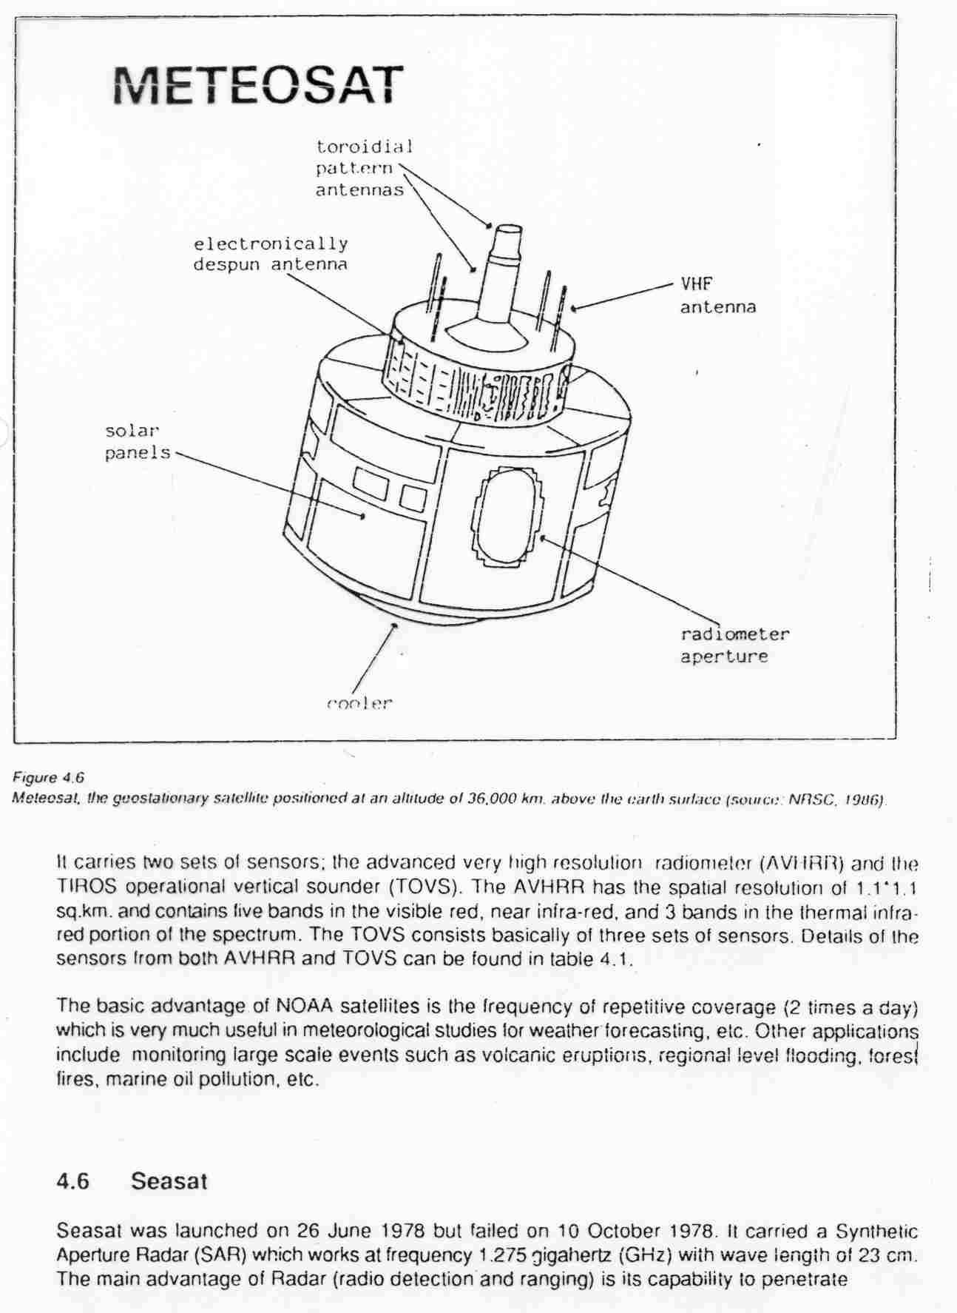

Slide 40
TERRA (EOS)
Terra (EOS) is a multi-national NASA scientific research satellite in a sun-synchronous orbit around the Earth.
The name "Terra" comes from the Latin word for Earth.
The satellite was launched on December 18, 1999, and began collecting data on February 24, 2000.
Terra carries five remote sensors designed to monitor the state of Earth's environment and on going changes in its climate system:
ASTER - Advanced Spaceborne Thermal Emission and Reflection Radiometer
CERES - Clouds and the Earth's Radiant Energy System
MISR - Multi-angle Imaging Spectro-radiometer
MODIS - Moderate-resolution Imaging Spectroradiometer
MOPITT - Measurements of Pollution in the Troposphere
http://edcdaac.usgs.gov/main.html
Assignment: Find out the spatial, spectral and temporal resolution of these five sensors
Notes:
ASTER - http://visibleearth.nasa.gov/Sensors/Terra/ASTER.html
CERES - http://visibleearth.nasa.gov/Sensors/Terra/CERES.html
MISR - http://visibleearth.nasa.gov/Sensors/Terra/MISR.html
MODIS - http://visibleearth.nasa.gov/Sensors/Terra/MODIS.html
MOPITT - http://visibleearth.nasa.gov/Sensors/Terra/MOPITT.html

Slide 41
AQUA (EOS)
Aqua (EOS) is NASA scientific research satellite in orbit around the Earth, studying the precipitation, evaporation, and cycling of water.
It is the second major component of the EOS launched 2002.
The name "Aqua" comes from the Latin word for water.
Aqua carries six instruments for studies of water on the Earth's surface and in the atmosphere:
AMSR-E — Advanced Microwave Scanning Radiometer-EOS — measures cloud properties, sea surface temperature, near-surface wind speed, radiative energy flux, surface water, ice and snow.
MODIS — Moderate Resolution Imaging Spectroradiometer, also measures cloud properties and radiative energy flux, also aerosol properties; land cover and land use change, fires and volcanos. This instrument is also aboard Terra.
Notes:
“Aqua,” Latin for “water,” is a NASA Earth Science satellite mission named for the large amount of information that the mission will be collecting about the Earth’s water cycle, including evaporation from the oceans, water vapor in the atmosphere, clouds, precipitation, soil moisture, sea ice, land ice, and snow cover on the land and ice. Additional variables also being measured by Aqua include radiative energy fluxes, aerosols, vegetation cover on the land, phytoplankton and dissolved organic matter in the oceans, and air, land, and water temperatures.
Aqua will carry six state-of-the-art instruments in a near-polar low-Earth orbit. The six instruments are the Atmospheric Infrared Sounder (AIRS), the Advanced Microwave Sounding Unit (AMSU-A), the Humidity Sounder for Brazil (HSB), the Advanced Microwave Scanning Radiometer for EOS (AMSR-E), the Moderate-Resolution Imaging Spectroradiometer (MODIS), and Clouds and the Earth's Radiant Energy System (CERES). Each has unique characteristics and capabilities, and all six serve together to form a powerful package for Earth observations.
The Atmospheric Infrared Sounder (AIRS), an advanced sounder containing 2378 infrared channels and four visible/near-infrared channels, aimed at obtaining highly accurate temperature profiles within the atmosphere plus a variety of additional Earth/atmosphere products. AIRS will be the highlighted instrument in the AIRS/AMSU-A/HSB triplet centered on measuring accurate temperature and humidity profiles throughout the atmosphere. The Advanced Microwave Radiometer for EOS (AMSR-E) is a twelve-channel, six-frequency, total power passive-microwave radiometer system. It measures brightness temperatures at 6.925, 10.65, 18.7, 23.8, 36.5, and 89.0 GHz. Vertically and horizontally polarized measurements are taken at all channels. The Earth-emitted microwave radiation is collected by an offset parabolic reflector 1.6 meters in diameter that scans across the Earth along an imaginary conical surface, maintaining a constant Earth incidence angle of 55° and providing a swath width array of six feedhorns which then carry the radiation to radiometers for measurement. Calibration is accomplished with observations of cosmic background radiation and an on-board warm target. Spatial resolution of the individual measurements varies from 5.4 km at 89.0 GHz to 56 km at 6.9 GHz. The Advanced Microwave Sounding Unit (AMSU-A), a 15-channel microwave sounder designed primarily to obtain temperature profiles in the upper atmosphere (especially the stratosphere) and to provide a cloud-filtering capability for tropospheric temperature observations. The first AMSU was launched in May 1998 on board the National Oceanic and Atmospheric Administration's (NOAA's) NOAA 15 satellite. The EOS AMSU-A will be part of a closely coupled triplet of instruments that include the AIRS and HSB.
The Cloud's and the Earth's Radiant Energy System (CERES) is a 3-channel radiometer measuring reflected solar radiation in the 0.3-5 µm wavelength band, emitted terrestrial radiation in the 8-12 µm band, and total radiation from 0.3 µm to beyond 100 µm. These data will be used to measure the Earth's total thermal radiation budget, and, in combination with MODIS data, detailed information about clouds. The first CERES instrument was launched on the Tropical Rainfall Measuring Mission (TRMM) satellite in November 1997; the second and third CERES instuments were launched on the Terra satellite in December 1999; and the fourth and fifth CERES instruments will be on board the Aqua satellite.
The Humidity Sounder for Brazil (HSB), a 4-channel microwave sounder provided by Brazil aimed at obtaining humidity profiles throughout the atmosphere. The HSB is the instrument in the AIRS/AMSU-A/HSB triplet that will allow humidity measurements even under conditions of heavy cloudiness and haze.
The Moderate Resolution Imaging Spectroradiometer (MODIS), is a 36-band spectroradiometer measuring visible and infrared radiation and obtaining data that will be used to derive products ranging from vegetation, land surface cover, and ocean chlorophyll fluorescence to cloud and aerosol properties, fire occurrence, snow cover on the land, and sea ice cover on the oceans. The first MODIS instrument was launched on board the Terra satellite in December 1999.

Slide 42
AQUA (EOS)
AMSU-A — Advanced Microwave Sounding Unit — measures atmospheric temperature and humidity.
AIRS — Atmospheric Infrared Sounder — measures atmospheric temperature and humidity, land and sea surface temperatures.
HSB — Humidity Sounder for Brazil — VHF band equipment measuring atmospheric humidity. Furnished by Instituto Nacional de Pesquisas Espaciais of Brazil. The HSB instrument has been in survival mode since 2/5/2003.
CERES — Clouds and the Earth's Radiant Energy System, Flying Models 3 and 4, measure broadband radiative energy flux.
Notes:
“Aqua,” Latin for “water,” is a NASA Earth Science satellite mission named for the large amount of information that the mission will be collecting about the Earth’s water cycle, including evaporation from the oceans, water vapor in the atmosphere, clouds, precipitation, soil moisture, sea ice, land ice, and snow cover on the land and ice. Additional variables also being measured by Aqua include radiative energy fluxes, aerosols, vegetation cover on the land, phytoplankton and dissolved organic matter in the oceans, and air, land, and water temperatures.
Aqua will carry six state-of-the-art instruments in a near-polar low-Earth orbit. The six instruments are the Atmospheric Infrared Sounder (AIRS), the Advanced Microwave Sounding Unit (AMSU-A), the Humidity Sounder for Brazil (HSB), the Advanced Microwave Scanning Radiometer for EOS (AMSR-E), the Moderate-Resolution Imaging Spectroradiometer (MODIS), and Clouds and the Earth's Radiant Energy System (CERES). Each has unique characteristics and capabilities, and all six serve together to form a powerful package for Earth observations.
The Atmospheric Infrared Sounder (AIRS), an advanced sounder containing 2378 infrared channels and four visible/near-infrared channels, aimed at obtaining highly accurate temperature profiles within the atmosphere plus a variety of additional Earth/atmosphere products. AIRS will be the highlighted instrument in the AIRS/AMSU-A/HSB triplet centered on measuring accurate temperature and humidity profiles throughout the atmosphere. The Advanced Microwave Radiometer for EOS (AMSR-E) is a twelve-channel, six-frequency, total power passive-microwave radiometer system. It measures brightness temperatures at 6.925, 10.65, 18.7, 23.8, 36.5, and 89.0 GHz. Vertically and horizontally polarized measurements are taken at all channels. The Earth-emitted microwave radiation is collected by an offset parabolic reflector 1.6 meters in diameter that scans across the Earth along an imaginary conical surface, maintaining a constant Earth incidence angle of 55° and providing a swath width array of six feedhorns which then carry the radiation to radiometers for measurement. Calibration is accomplished with observations of cosmic background radiation and an on-board warm target. Spatial resolution of the individual measurements varies from 5.4 km at 89.0 GHz to 56 km at 6.9 GHz. The Advanced Microwave Sounding Unit (AMSU-A), a 15-channel microwave sounder designed primarily to obtain temperature profiles in the upper atmosphere (especially the stratosphere) and to provide a cloud-filtering capability for tropospheric temperature observations. The first AMSU was launched in May 1998 on board the National Oceanic and Atmospheric Administration's (NOAA's) NOAA 15 satellite. The EOS AMSU-A will be part of a closely coupled triplet of instruments that include the AIRS and HSB.
The Cloud's and the Earth's Radiant Energy System (CERES) is a 3-channel radiometer measuring reflected solar radiation in the 0.3-5 µm wavelength band, emitted terrestrial radiation in the 8-12 µm band, and total radiation from 0.3 µm to beyond 100 µm. These data will be used to measure the Earth's total thermal radiation budget, and, in combination with MODIS data, detailed information about clouds. The first CERES instrument was launched on the Tropical Rainfall Measuring Mission (TRMM) satellite in November 1997; the second and third CERES instuments were launched on the Terra satellite in December 1999; and the fourth and fifth CERES instruments will be on board the Aqua satellite.
The Humidity Sounder for Brazil (HSB), a 4-channel microwave sounder provided by Brazil aimed at obtaining humidity profiles throughout the atmosphere. The HSB is the instrument in the AIRS/AMSU-A/HSB triplet that will allow humidity measurements even under conditions of heavy cloudiness and haze.
The Moderate Resolution Imaging Spectroradiometer (MODIS), is a 36-band spectroradiometer measuring visible and infrared radiation and obtaining data that will be used to derive products ranging from vegetation, land surface cover, and ocean chlorophyll fluorescence to cloud and aerosol properties, fire occurrence, snow cover on the land, and sea ice cover on the oceans. The first MODIS instrument was launched on board the Terra satellite in December 1999.

Slide 43
ASTER
Advanced Spaceborne Thermal Emission and Reflection Radiometer
Also known as Intermediate Thermal Infrared Radiometer – ITIR
Currently on TERRA satellite
VISIBLE
NIR
SWIR
400
500
600
700
800
900
1000
nm
15 m
1
2
3
Notes:
Sensor Description:
ASTER data products will exploit the spectrum of emissivity and reflectivity from clouds, soil and geologic surfaces, and volcanoes. VNIR and SWIR bands will be used to study land use patterns and vegetation; VNIR and TIR combinations for the study of coral reefs and glaciers; and VNIR for Digital Elevation Models (DEMs). TIR channels will be used to study evapotranspiration, and land and ocean temperature.

Slide 44
ASTER
3 channels of VNIR (15 m)
6 channels of SWIR (30 m)
5 channels of TIR (90m)
Capable of stereoscopic imagery
Channel 3 contains 25 meter “overlap”
Free to NASA researchers or $55 a scene
http://asterweb.jpl.nasa.gov/
http://edcdaac.usgs.gov/main.html

Slide 46
Benefits of ASTER
Land Use and Land Cover
Natural Disaster Prediction and Monitoring
Short Term Climate Variability
Hydrology
NIR bands can generate along track stereo image pairs thus used for high quality DTM
Revisit time is 5 days for VNIR channels

Slide 47
MODIS
Moderate Resolution Imaging Spectroradiometer
36 spectral bands – 12 bit resolution
Currently on TERRA or AQUA satellites
Revisit time for sensor is 1 – 2 days
VISIBLE
NIR
SWIR
400
500
600
700
800
900
1000
nm
250 m
8
9
3
4
1
2
Only showing bands 1-9 within the VNIR
Notes:
MODIS (or Moderate Resolution Imaging Spectroradiometer) is a key instrument aboard the Terra (EOS AM) and Aqua (EOS PM) satellites. Terra's orbit around the Earth is timed so that it passes from north to south across the equator in the morning, while Aqua passes south to north over the equator in the afternoon. Terra MODIS and Aqua MODIS are viewing the entire Earth's surface every 1 to 2 days, acquiring data in 36 spectral bands, or groups of wavelengths (see MODIS Technical Specifications). These data will improve our understanding of global dynamics and processes occurring on the land, in the oceans, and in the lower atmosphere. MODIS is playing a vital role in the development of validated, global, interactive Earth system models able to predict global change accurately enough to assist policy makers in making sound decisions concerning the protection of our environment.
MODIS Design Concept The MODIS instrument provides high radiometric sensitivity (12 bit) in 36 spectral bands ranging in wavelength from 0.4 µm to 14.4 µm. The responses are custom tailored to the individual needs of the user community and provide exceptionally low out-of-band response. Two bands are imaged at a nominal resolution of 250 m at nadir, with five bands at 500 m and the remaining 29 bands at 1,000 m. A ±55-degree scanning pattern at the EOS orbit of 705 km achieves a 2,330-km swath and provides global coverage every one to two days. The Scan Mirror Assembly uses a continuously rotating double-sided scan mirror to scan ±55-degree driven by a motor encoder built to operate at 100 percent duty cycle throughout the 6-year instrument design life. The optical system consists of a two-mirror off-axis afocal telescope which directs energy to four refractive objective assemblies; one for each of the VIS, NIR, SWIR/MWIR and LWIR spectral regions covering a total spectral range of 0.4 to 14.4 µm. A high-performance passive radiative cooler provides cooling to 83K for the 20 infrared spectral bands on two HgCdTe Focal Plane Assemblies (FPAs). Novel photodiode-silicon readout technology for the visible and near infrared provide unsurpassed quantum efficiency and low-noise readout with exceptional dynamic range. Analog programmable gain and offset and FPA clock and bias electronics are located near the FPAs in two dedicated electronics modules, the Space-viewing Analog Module (SAM) and the Forward-viewing Analog Module (FAM) . A third main electronics module (MEM) provides power, control systems, command and telemetry, and calibration electronics. In addition, the system includes four on-board calibrators as well as a view to space: a Solar Diffuser (SD), a v-groove Blackbody (BB), a Spectroradiometric calibration assembly (SRCA), and a Solar Diffuser Stability Monitor (SDSM). The first MODIS Flight Instrument, ProtoFlight Model or PFM, is integrated on the Terra (EOS AM-1) spacecraft. Terra successfully launched on December 18, 1999. The second MODIS flight instrument, Flight Model 1 or FM1, is in the final stages of acceptance testing. Once it is ready, FM1 will be integrated on the Aqua (EOS PM-1) spacecraft. These MODIS instruments will offer an unprecedented look at terrestrial, atmospheric, and ocean phenomenology for a wide and diverse community of users throughout the world.

Slide 48
MODIS
Terra MODIS and Aqua MODIS are viewing the entire Earth's surface every 1 to 2 days, acquiring data in 36 spectral bands, or groups of wavelengths (see MODIS Technical Specifications).
Currently free to researchers
Data imports use the HDF format
http://modarch.gsfc.nasa.gov/
http://daac.gsfc.nasa.gov/MODIS/
http://edcdaac.usgs.gov/main.html
Notes:
MODIS (or Moderate Resolution Imaging Spectroradiometer) is a key instrument aboard the Terra (EOS AM) and Aqua (EOS PM) satellites. Terra's orbit around the Earth is timed so that it passes from north to south across the equator in the morning, while Aqua passes south to north over the equator in the afternoon. Terra MODIS and Aqua MODIS are viewing the entire Earth's surface every 1 to 2 days, acquiring data in 36 spectral bands, or groups of wavelengths (see MODIS Technical Specifications). These data will improve our understanding of global dynamics and processes occurring on the land, in the oceans, and in the lower atmosphere. MODIS is playing a vital role in the development of validated, global, interactive Earth system models able to predict global change accurately enough to assist policy makers in making sound decisions concerning the protection of our environment.
MODIS Design Concept The MODIS instrument provides high radiometric sensitivity (12 bit) in 36 spectral bands ranging in wavelength from 0.4 µm to 14.4 µm. The responses are custom tailored to the individual needs of the user community and provide exceptionally low out-of-band response. Two bands are imaged at a nominal resolution of 250 m at nadir, with five bands at 500 m and the remaining 29 bands at 1,000 m. A ±55-degree scanning pattern at the EOS orbit of 705 km achieves a 2,330-km swath and provides global coverage every one to two days. The Scan Mirror Assembly uses a continuously rotating double-sided scan mirror to scan ±55-degree driven by a motor encoder built to operate at 100 percent duty cycle throughout the 6-year instrument design life. The optical system consists of a two-mirror off-axis afocal telescope which directs energy to four refractive objective assemblies; one for each of the VIS, NIR, SWIR/MWIR and LWIR spectral regions covering a total spectral range of 0.4 to 14.4 µm. A high-performance passive radiative cooler provides cooling to 83K for the 20 infrared spectral bands on two HgCdTe Focal Plane Assemblies (FPAs). Novel photodiode-silicon readout technology for the visible and near infrared provide unsurpassed quantum efficiency and low-noise readout with exceptional dynamic range. Analog programmable gain and offset and FPA clock and bias electronics are located near the FPAs in two dedicated electronics modules, the Space-viewing Analog Module (SAM) and the Forward-viewing Analog Module (FAM) . A third main electronics module (MEM) provides power, control systems, command and telemetry, and calibration electronics. In addition, the system includes four on-board calibrators as well as a view to space: a Solar Diffuser (SD), a v-groove Blackbody (BB), a Spectroradiometric calibration assembly (SRCA), and a Solar Diffuser Stability Monitor (SDSM). The first MODIS Flight Instrument, ProtoFlight Model or PFM, is integrated on the Terra (EOS AM-1) spacecraft. Terra successfully launched on December 18, 1999. The second MODIS flight instrument, Flight Model 1 or FM1, is in the final stages of acceptance testing. Once it is ready, FM1 will be integrated on the Aqua (EOS PM-1) spacecraft. These MODIS instruments will offer an unprecedented look at terrestrial, atmospheric, and ocean phenomenology for a wide and diverse community of users throughout the world.

